Slide 1

ENVIRONMENTAL STUDIES
GROUP-13
AMAZON FOREST FIRE
PROJECT ASSIGNED BY:PROFESSOR RANENDU GHOSH

Slide 2
Members Of Group 13
Patel Utsav 201801148
Rughani Akshar 201801149
Katrodiya Parth 201801150
Chavda Dhruv 201801151
Doshi Mihir 201801152
Patel Kiran Kumar 201801153
Rajani Harsh 201801154
Mehta Soham 201801155
Ramoliya Himanshu 201801156
Thakarar Keval 201801157
Nakarani Hemang 201801158
Joshi Dikshen 201801159
Trivedi Daksh 201801160
Verma Palak 201801161
Bhavsar Raj 201801437
Chaudhary Hiren 201801438
Dave Naman 201801439

Slide 3
Forest Fire
Forest fire is an uncontrolled fire which wipes away large fields and land areas
Forest fire causes nature imbalance and endangers biodiversity by reducing the abundance of fauna and flora.
There are many factors that decides how fire spreads and how intense it will be.They include weather,fuel and topography

Slide 4
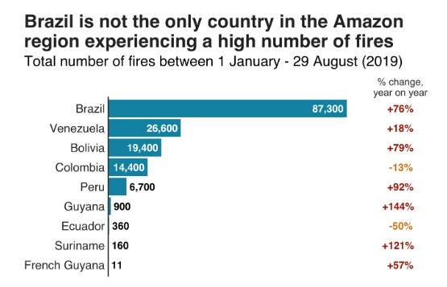
Trends Of Forest Fire In The World
There are many trends according to different regions but many of them are most common.
• There are more fires.
•Those fires are larger.
•The same area keeps burning.
•Recent fires are burning more coniferous forests than other types of landscape

Slide 5
History of fires in Amazon forests
Forests of Amazon shows no trace of Natural fires as it turns out the beings of this habitat cannot survive such fires.
The Amazonians used controlled fires to clear the areas for agriculture which were quite different from those of today’s as they used to leave the trees standing. Those fires were less intense and frequent that would not spread in uncontrolled manner.
But those fires over the years made the rainforests more fire prone today.

Slide 6
Types Of Forest Fires
We can divide Forest Fire into main 5 types
Surface Fire : A fire that is primarily along the surface and is spreading through the forest floor is known as Surface fire.This contains leaves that have fallen down and grass.
Underground Fire : The fires of low intensity, consuming the organic matter beneath and the surface litter of the forest floor are sub-grouped as underground fire.
Ground Fire : These fires are fires in the subsurface organic fuels. There is no clear distinction between underground and ground fires. It is possible that sometimes underground may get converted into ground fire due to an increase in burning content.
Crown Fire : A crown fire is one in which the crown of trees and shrubs burn, often sustained by a surface fire. A crown fire is particularly very dangerous as it can burn furiously.
Firestorms : Among all the forest fires,this spread very quickly, which is an intense fire over a large area. As the fire burns, heat rises and air rushes in, causing the fire to grow.

Slide 7
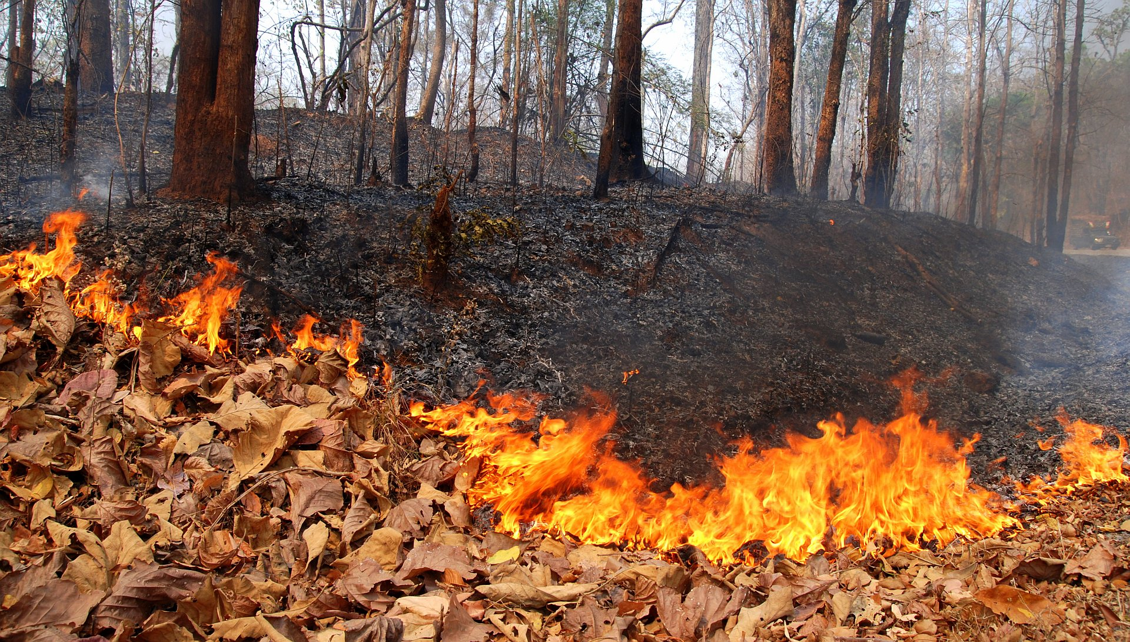
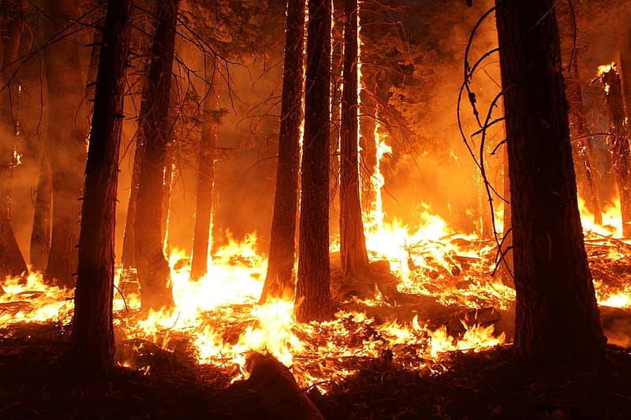
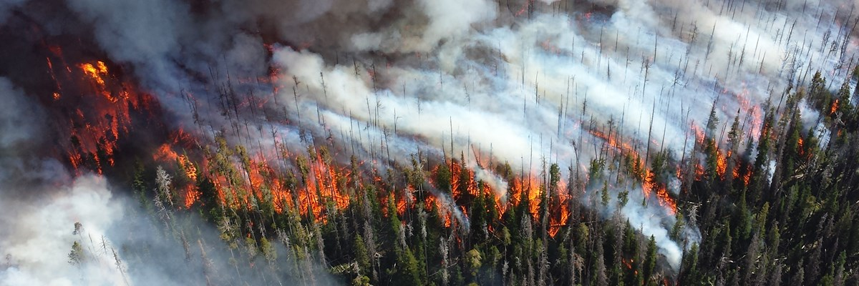
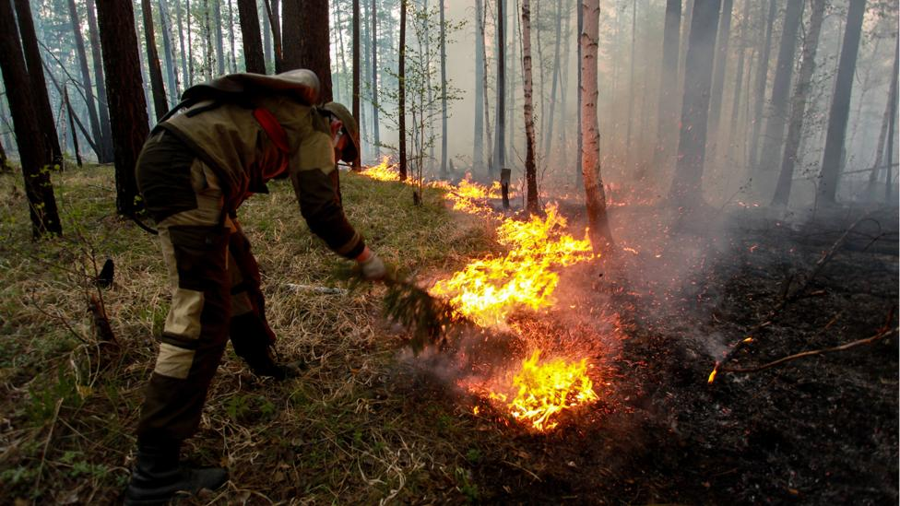
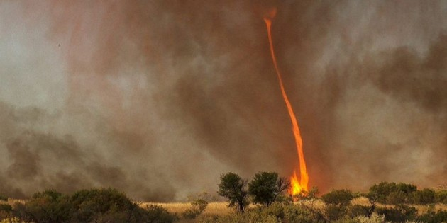
Surface Fire
Ground Fire
Crown Fire
Underground Fire
Firestorm

Slide 8
Causes Of Forest Fire
Main two Classes :
1) Natural caused
Fires caused by natural events like atmospheric temperature, pressure, humidity in the atmosphere as well as the soil, precipitation, percolation, wind speed and directions.
Eg. lightning which sets trees on fire. But rain extinguishes the fire caused by lightning.
2) Human caused
Fire is caused when a source of fire like naked flame, electric spark or any source of ignition comes into contact with inflammable material.
Fires caused by man-made events constitute the greater percentage of forest fires in our forests.
Eg. Villagers use fire to ward off wild animals or Careless visitors to forests who discard cigarette butts can also set fire in the forest.

Slide 9
Why Study Of Amazon Forest Fire is Necessary?
The Amazon forest covers approximately 6.7 million square kilometers, 60% area is located within Brazil, thus political situation in Brazil has a large impact on the region.
The Amazon rainforest contains highest biodiversity than anywhere else.
30% of world known species.
390 billion trees.
Amazon river contain the largest number of freshwater species.
These groups have the most to lose from land-use changes related to forest fires.
Fire could deliver a huge blow to the global fight against climate change because of excess amount of CO2 and pollutants in the atmosphere. There is less moisture released into the atmosphere, which can result into less rainfall.
According to Brazil’s space agency, INPE, the number of fires is up 85% from the same period last year. It is clear that the region’s hydrological and climatic status will change drastically if the situation continues to worsen.
Notes:
The National Institute for Space Research (Portuguese: Instituto Nacional de Pesquisas Espaciais, INPE)

Slide 10
How Widespread Are Fires In Amazon Forest?
INPE (research unit of the Brazilian Ministry of Science) has reported more than 80,000 fires across all of Brazilian-subcontinent
The number of fires burning across the Amazon in 2019 is higher than at any point since 2010
However, 2019 is not the worst year in recent history. Brazil experienced more fire activity in the 2000s - with 2005 seeing more than 142,000 fires in the first eight months of the year.
The recent increase in the number of fires in the Amazon is directly related to intentional deforestation and not the result of an extremely dry season, according to the Amazon Environmental Research Institute

Slide 11
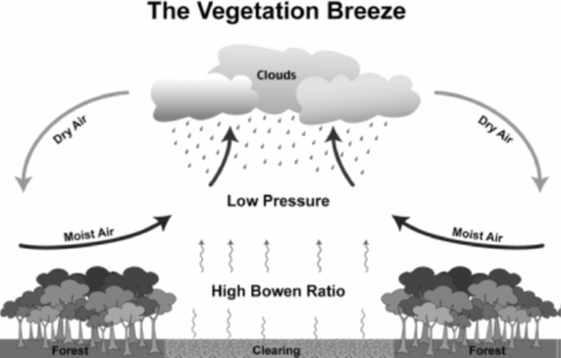
How can there be fire in RainForest ?
Amazon does have dry season but dry season still have lot of water But during elnino year condition is different.
Vegetation Breeze phenomena explain how moist air of forest are convert into dry air.
This phenomena are peak when land clearances around 100 - 150 km in diameter.
Due to human intervention in Amazon Rainforest. This vegetation breeze effect are observing in rainforest.

Slide 12
How Did Fire Start?
“About 99% of the Amazon fires start from human actions, “either on purpose or by accident”. -Alberto Setzer
It started by people clearing land for farming, ranching, mining, logging, and infrastructure, which is normal during deforestation in Amazon but 2019 has more fire activity than in a year since 2010.
After clearing the forest area, fires are ignited using slash-and-burn to put nutrients in the soil.
60% of the Amazon lies within Brazil, that means environmental laws fluctuate as the Brazilian economy.
Former President Lula in 2004 launched a plan to deal with deforestation.From 2004 to 2014 it was a massive success however in 2015 and 2016, Brazil had deep recession so rates rose again from 2015 .
Many people pointed to the weather, but as we look at the locations of fire it tends to be more motivated by economic pressures rather than climate condition.
An organized day of burning called “Fire Day” was scheduled on August 10th. IBAMA was tasked to stop deforestation fires in Amazon but the state police refused its support. So, the fire increased in the area and later in southern Amazon.

Slide 13
Deforestation
Deforestation is huge numbers of cutting down trees in the forest.
The main purpose of deforestation is to increase the land area for setting up new industries.
It has many harmful effects like soil erosion, landslides, floods, global warming, impact on the water cycle, major change to biodiversity etc.
Deforestation happens due to many reasons such as logging, mining , urbanization etc.
Logging, or cutting down trees in a forest to harvest timber for wood, products or fuel, is a primary driver of deforestation.
Mining causes deforestation as digging for coal, diamond or gold requires removal of large forest removal.

Slide 14
Effect of Forest fire on Animal life and on Biodiversity.
Amazon has more than 40000 plant species, 3000 plus freshwater fish species and 370 plus types of reptiles.
On Animals:- According to WORLD WIDE LIFE one in ten known species on Earth resides in Amazon.There are certain types of forest that are habitat towards fire but amazon is not one of them.So each species has to suffer a lot of changes in their cycle due to such fires.
- Result of this was Jaguars living their got extinct. If actions were not taken than might be possibility that with time more species got endangered.
- Another species is Giant Otters and their might be possibilities that some species before they were discovered might loss their existence.
- Aquatic life also get disturbed when ashes of fire mixes with water it temperature get raised and some species cannot survive with this change. Also this alter oxygen level in water.
On Ecosystem:- Smoke fire can reduce photosynthesis by blocking the sun rays. Also after such huge or small fires but large in number takes place their is huge change in carbon and oxygen amount.
- Also it has impact on food chain. It also leads to change in fertility of soil or might destroy it.

Slide 15
Prevention Of Forest Fire
Follow rules made by local government and stay alert
Check weather before burning anything.
Check your state's most current fire danger rating system.
Choose the place for campfire carefully.
Burn anything in campfire after acquiring complete knowledge about that substance.
Maintain high diversity in species and limit the surface fuels.
Flame resistant materials should be used at regular intervals.

Slide 16
What Brazil government did to stop Amazon forest fire?
President, Jair Bolsonaro blamed non-governmental organizations for Amazon forest fire.
He appointed a team to investigated Amazon fire.
Brazil government claimed that they didn’t have sufficient resources to fight against fire.
After a lot of pressure from the world he deployed the military to battle against fire on August 24.
According to Paulo Barroso, it was a complex operation, and more than 10,400 firefighters were spread across 55 lakh square kilometers in Amazon.

Slide 17
Climate change and Amazon forest fire...
Climate change is a factor not a cause for the devastating Amazon forest fire.
Amazon rainforest are nearing a tipping point, when triggered will convert the rainforest into Savannah.
The process is called Dieback and it will take about 30 to 50 years.
Climate change intensifies Amazon fires, turning it into carbon source from carbon sink.
As a result it will increase pace of global warming, damage Amazon tree species richness and thus harming biodiversity of that region.
Notes:
It is factor...tinderbox condition is cause.climate change is factor in addition to deforestation . In dieback amazon will become savana to become source instead of sink of CO2

Slide 18
Effects of Politics…
Brazilian Govt. have vision of Building country’s interior
The Explicative thing is there are 80% more flame in 2019 compare to 2018
Jair Bolsonaro, President of Brazil Govt. Decided Some arrangements like
Support agribusiness
Take the territory of indigenous tribes
Stops funding to the Brazilian Natural office
Enormous amount of consuming wood from forest in August 2019
Create Atomic and Hydroelectric force in Amazon basin
… Using this fund for country’s development

Slide 19
Is Amazon fire fault of President Jair Bolsonaro?
It was found out that the Brazilian President and their environmental minister Ricardo Salles haven't tried to stop the fire but have encouraged it for their profit.
In 2018 the number of fires increased by 77%.
Deforestation was found to be an affirmative goal of Bolsonaro
Bolsonaro and Salles view deforestation as such a pressing priority that they openly despise anyone who seeks to impede it.
As the New York Times put it “The destruction of the Amazon in Brazil has increased rapidly since the nation’s new far-right president took over and his government scaled back efforts to fight illegal logging, ranching and mining.”
Identifying the culprit is necessary but not sufficient to reduce environmental disaster.It is responsibility of entire humanity to do so.
Notes:
Bolsonaro fired a scientist after he warned about deforestation

Slide 20
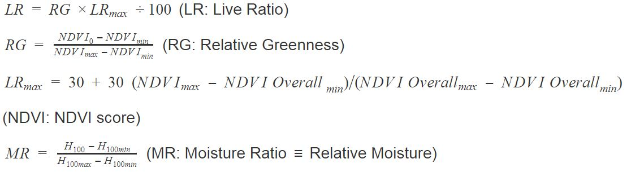
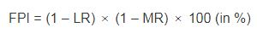
Determining Fire Hotspots in the Southern Amazon Rainforest
Through satellite image processing
Deriving the Fire Potential Index per pixel and showing the results.
Using GEE we’ve received GeoTiff images of MODIS-NDVI and TRMM values of the region.
MODIS-NDVI gives us greenness hence the Live Ratio (LR) or the Dead Fuel Ratio
TRMM gives 100-h precipitation hence the moisture ratio (MR) (equations are given below)

Slide 21
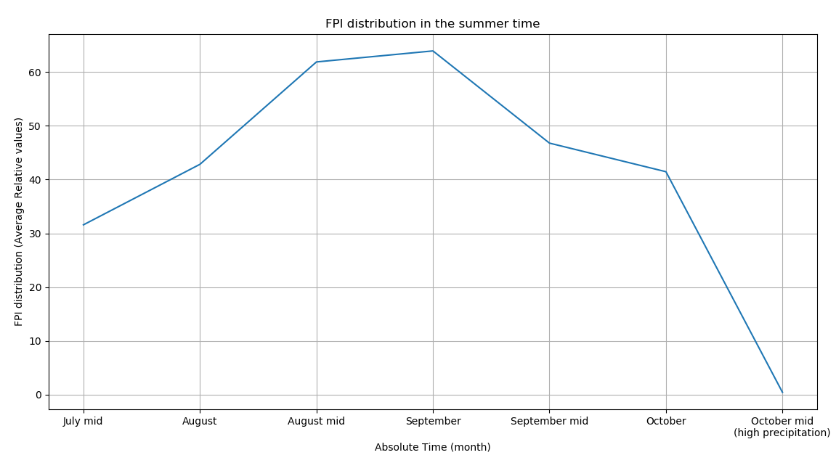
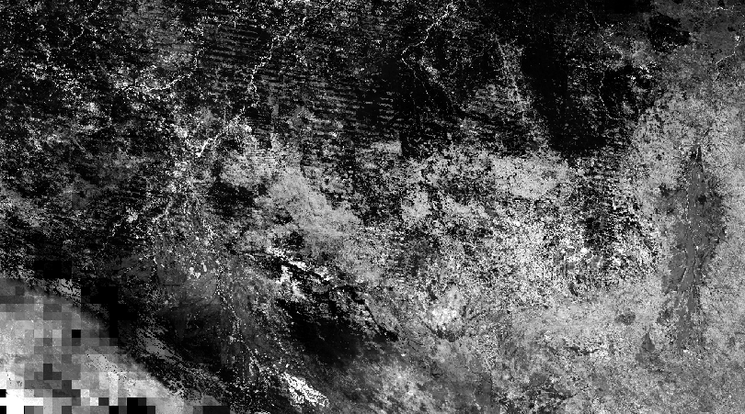
Results:
FPI images in the summer
FPI values’ graph

Slide 22
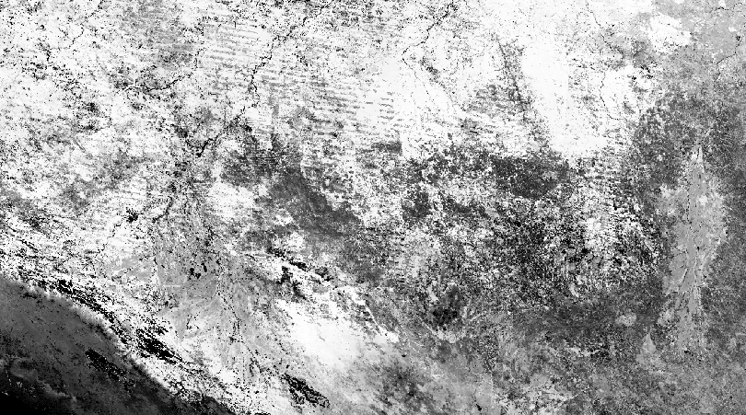

LR images in the summer
MR images in the summer

Slide 23
In FPI.gif we can clearly see that in August-September days there are more fire hotspots than any other days.
We can clearly see that the areas where the forest fire happened are amongst these fire hotspots.
These fire hotspots are increased in the areas where illegal deforestation happens in the areas of northern Bolivia ,south Amazonia state in Brazil and the actual south Amazon rainforest.
In the beginning of October (or late September), we can clearly see that the fire hotspots are reduced. Because the rainfall starts at the same time. Hence the MR is increased by a very large value because of having rainforest. It implies that 1 – MR is close to zero hence the FPI vanishes to nearly 0. The other reason can be given as by increasing rain, the dead fuel values decreases as greenery increases hence LR increases and 1 – LR decreases hence the FPI is lowered further.
We took the average FPI across the region and it came out to be 44.2% or 0.442 which is very close to the actual vulnerability index of the region (around 0.401). And it is in the region of all the vulnerability indices which are varying from 0.400 to 0.460. So the answers are precisely defining the actual event that is the Amazon forest fire.

Slide 24
The Amazon forest fire occurred in August, 2019 is not the worst case where the highest forest fires were reported. The worst year is around 2007-08.
Thereafter the forest fire reports were controlled till 2016-17. But now they are increasing rapidly which is why it's been a terrific concern all across the world.
The causes for such alarming forest fires are nothing but man made illegal deforestation(Huge impact upon LR-Live Ratio) and global warming which causes irregularity in annual rainfall thus it has a huge impact upon the MR-Moisture Ratio.

Slide 25
Conclusion

Slide 26
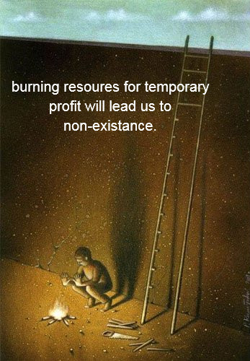
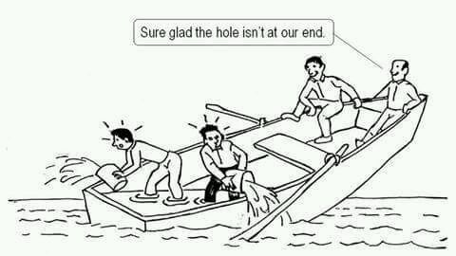
Burning forest will disturb nature's balance and lead human race to dead end.So we shouldn’t use natural resources limitlessly. we should use them for development but in limit as it’s our duty to give our future generation a better life.
“Glad the hole isn’t at our end”--This thought is our biggest mistake. Imagine the hole in the boat as forest fire.Most of the time the fires are not taken up seriously worldwide thinking the hole isn’t at our end.
Notes:
We need to change this thinking

